Slide 1
Mechanism Design
John P Dickerson and Marina Knittel
Lecture #9 – 02/21/2022
CMSC498T
Mondays & Wednesdays
2:00pm – 3:15pm

Slide 2
Quiz Review!

Slide 3
Last Week
Stable marriage problem
Bipartite, one vertex to one vertex
Gale-Shapley can always find this in poly-time by having jockeys propose to horses, but this favors jockeys
There are lots of variants of the problem that break theory
Stable roommates problem
Not bipartite, one vertex to one vertex
Irving’s algorithm finds a stable matching if it exists, otherwise reports failure
Hospitals/Residents problem
Bipartite, one vertex to many vertices
Actually used in practice (NRMP, lawyers, sororities)
Lots of finicky details for handling complementaries

Slide 4
This class: The Affiliate Matching Problem (Dooley & Dickerson ‘20)

Slide 5
Activity time!
Take this survey:
https://tinyurl.com/affmatch

Slide 6




The basis: One-to-Many
Capacity 2
Capacity 2
Capacity 2

Slide 7
Affiliations
Capacity 2
Capacity 2
Capacity 2

Slide 8



Affiliations
MD
Does the student like this?
Capacity 2
Does Penn State like this?
MD
Does UMD like this?
MD
Capacity 2
PA
PA
Capacity 2
WV

Slide 9
Affiliations
Student would rather match to WVU
MD
Capacity 1
MD
UMD likes its match but REALLY prefers its students to go to WVU than PSU.
MD
Capacity 1
PA
PA
Capacity 1
Student would rather match to UMD
WV

Slide 10
Affiliations
Student would rather match to WVU
MD
Capacity 1
MD
UMD likes its match but REALLY prefers its students to go to WVU than PSU.
MD
Capacity 1
PA
PA
Capacity 1
Student would rather match to UMD
WV

Slide 11
Affiliations
Student would rather match to WVU
MD
Capacity 1
MD
UMD likes its match but REALLY prefers its students to go to WVU than PSU.
MD
Capacity 1
PA
PA
Capacity 1
Student would rather match to UMD
WV

Slide 12
Affiliations
Student would rather match to WVU
MD
Capacity 1
MD
UMD likes its match but REALLY prefers its students to go to WVU than PSU.
MD
Capacity 1
PA
PA
Capacity 1
Student would rather match to UMD
WV

Slide 13
Affiliations: A Mathematical Formulation
MD
MD
Let U be the universities and S be the students.
Student preferences are just a ranked list over universities.
What about university preferences?
Let the capacity of a university be c(u)
For a university u, let its affiliates be aff(u) where n(u)=|aff(u)|
n(u) is the number of affiliates
u has a ranked list over S^{c(u)}×U^{n(u)}
Its and its affiliates matchings
Note: this notation differs from the associated paper
c(u) = 4
UMD cares about:
Its 4 matches
Affiliate 1 match
Affiliate 2 match
This is a 6-tuple:
(s, s’, s’’, s’’’, u’, u’’)

Slide 14
Underlying Preferences
MD
Capacity 1
Alex
PA
Capacity 1
Ryan
Setting
3 schools: UMD, PSU, WVU
3 students: Alex, Ryan, Taylor
Say UMD has a general preference over applicants it wants and schools it likes for Alex.
Alex >_{UMD} Ryan > _{UMD} Taylor
Penn State >_{UMD} Maryland > _{UMD} West Virginia
How will UMD rank overall matchings? It only cares about it’s and Alex’s match.
Represent a matching as: (UMD’s match, Alex’s match)
WV
Capacity 1
Taylor

Slide 15
Underlying Preferences
MD
Capacity 1
Alex
PA
Capacity 1
Alex >_{UMD} Ryan > _{UMD} Taylor
Penn State >_{UMD} Maryland > _{UMD} West Virginia
Matchings: (UMD’s match, Alex’s match)
Consider the following partial ranks UMD might have over matchings:
(Alex, PSU) >_{UMD} (Alex, WVU) >_{UMD} (Ryan, UMD)
(Alex, WVU) >_{UMD} (Alex, PSU) >_{UMD} (Ryan, UMD)
(Alex, UMD) >_{UMD} (Taylor, PSU) >_{UMD} (Ryan, PSU)
(Alex, UMD) >_{UMD} (Ryan, PSU) >_{UMD} (Taylor, PSU)
Ryan
WV
Capacity 1
Taylor
Disregarding impossible matches, which of these seem “rational” given UMD’s underlying preferences?
Which of these matches are impossible?

Slide 16
Underlying Preferences
MD
Capacity 1
Alex
PA
Capacity 1
Alex >_{UMD} Ryan > _{UMD} Taylor
Penn State >_{UMD} Maryland > _{UMD} West Virginia
Matchings: (UMD’s match, Alex’s match)
Consider the following partial ranks UMD might have over matchings:
(Alex, PSU) >_{UMD} (Alex, WVU) >_{UMD} (Ryan, UMD)
(Alex, WVU) >_{UMD} (Alex, PSU) >_{UMD} (Ryan, UMD)
(Alex, UMD) >_{UMD} (Taylor, PSU) >_{UMD} (Ryan, PSU)
(Alex, UMD) >_{UMD} (Ryan, PSU) >_{UMD} (Taylor, PSU)
Ryan
WV
Capacity 1
Taylor
Disregarding impossible matches, which of these seem “rational” given UMD’s underlying preferences?
Which of these matches are impossible?
(Alex, PSU): how can UMD be matched to Alex, but Alex is matched to PSU?

Slide 17
Underlying Preferences
MD
Capacity 1
Alex
PA
Capacity 1
Alex >_{UMD} Ryan > _{UMD} Taylor
Penn State >_{UMD} Maryland > _{UMD} West Virginia
Matchings: (UMD’s match, Alex’s match)
Consider the following partial ranks UMD might have over matchings:
(Alex, PSU) >_{UMD} (Alex, WVU) >_{UMD} (Ryan, UMD)
(Alex, WVU) >_{UMD} (Alex, PSU) >_{UMD} (Ryan, UMD)
(Alex, UMD) >_{UMD} (Taylor, PSU) >_{UMD} (Ryan, PSU)
(Alex, UMD) >_{UMD} (Ryan, PSU) >_{UMD} (Taylor, PSU)
Ryan
WV
Capacity 1
Taylor
Disregarding impossible matches, which of these seem “rational” given UMD’s underlying preferences?
Which of these matches are impossible?
(Alex, PSU): how can UMD be matched to Alex, but Alex is matched to PSU?

Slide 18
Underlying Preferences
MD
Capacity 1
Alex
PA
Capacity 1
Alex >_{UMD} Ryan > _{UMD} Taylor
Penn State >_{UMD} Maryland > _{UMD} West Virginia
Matchings: (UMD’s match, Alex’s match)
Consider the following partial ranks UMD might have over matchings:
(Alex, PSU) >_{UMD} (Alex, WVU) >_{UMD} (Ryan, UMD)
(Alex, WVU) >_{UMD} (Alex, PSU) >_{UMD} (Ryan, UMD)
(Alex, UMD) >_{UMD} (Taylor, PSU) >_{UMD} (Ryan, PSU)
(Alex, UMD) >_{UMD} (Ryan, PSU) >_{UMD} (Taylor, PSU)
Ryan
WV
Capacity 1
Taylor
Disregarding impossible matches, which of these seem “rational” given UMD’s underlying preferences?
1 seems rational, 2 does not.
Which of these matches are impossible?
(Alex, PSU): how can UMD be matched to Alex, but Alex is matched to PSU?

Slide 19
Underlying Preferences
MD
Capacity 1
Alex
PA
Capacity 1
Alex >_{UMD} Ryan > _{UMD} Taylor
Penn State >_{UMD} Maryland > _{UMD} West Virginia
Matchings: (UMD’s match, Alex’s match)
Consider the following partial ranks UMD might have over matchings:
(Alex, PSU) >_{UMD} (Alex, WVU) >_{UMD} (Ryan, UMD)
(Alex, WVU) >_{UMD} (Alex, PSU) >_{UMD} (Ryan, UMD)
(Alex, UMD) >_{UMD} (Taylor, PSU) >_{UMD} (Ryan, PSU)
(Alex, UMD) >_{UMD} (Ryan, PSU) >_{UMD} (Taylor, PSU)
Ryan
WV
Capacity 1
Taylor
Disregarding impossible matches, which of these seem “rational” given UMD’s underlying preferences?
1 seems rational, 2 does not.
4 seems rational, 3 does not.
How do we capture “rationality”?
Which of these matches are impossible?
(Alex, PSU): how can UMD be matched to Alex, but Alex is matched to PSU?

Slide 20
Consistent Preferences
In this model, we call “rational” preferences consistent. Say >_{u} is u’s preference over complete matchings, >’_{u} is its preference over students, and >’’_{u} is its preference over universities.
Formally:
An employer’s preference profile >_{u} consistent with >’_{u} (resp. >’’_{u}) if the ordering of the first element of each tuple preserves >’_{u} (resp. >’’_{u} ).
Alex >’_{UMD} Ryan >’ _{UMD} Taylor
Penn State >’’_{UMD} Maryland >’’ _{UMD} West Virginia
Then which is consistent with >’ _{UMD} and >’’ _{UMD} ?
(Ryan, PSU) >_{UMD} (Taylor, PSU) >_{UMD} (Ryan, WVU)
(Ryan, PSU) >_{UMD} (Ryan, WVU) >_{UMD} (Taylor, PSU)

Slide 21
Consistent Preferences
In this model, we call “rational” preferences consistent. Say >_{u} is u’s preference over complete matchings, >’_{u} is its preference over students, and >’’_{u} is its preference over universities.
Formally:
An employer’s preference profile >_{u} consistent with >’_{u} (resp. >’’_{u}) if the ordering of the first element of each tuple preserves >’_{u} (resp. >’’_{u} ).
Alex >’_{UMD} Ryan >’ _{UMD} Taylor
Penn State >’’_{UMD} Maryland >’’ _{UMD} West Virginia
Then which is consistent with >’ _{UMD} and >’’ _{UMD} ?
(Ryan, PSU) >_{UMD} (Taylor, PSU) >_{UMD} (Ryan, WVU) >’’ _{UMD}
(Ryan, PSU) >_{UMD} (Ryan, WVU) >_{UMD} (Taylor, PSU) >’ _{UMD}
We call this “affiliate-agnostic”

Slide 22
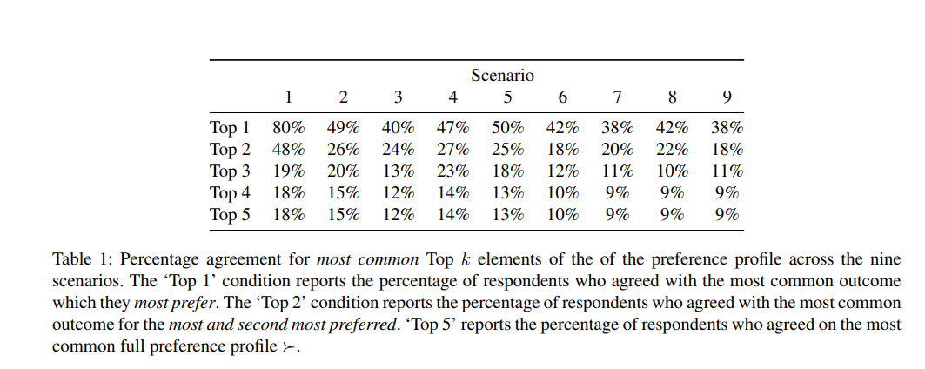
Survey: do real preferences vary?
You are BMU, your affiliate is Ryan.
BMU and Ryan top tier
BMU and Ryan bottom tier
Takeaways:
1/10 – 1/5 respondents agreed on complete profiles each question
Agreement is much higher for Top 1 and 2 (anecdotal strategies)
Agreement is higher when BMU and Ryan are top-tier

Slide 23
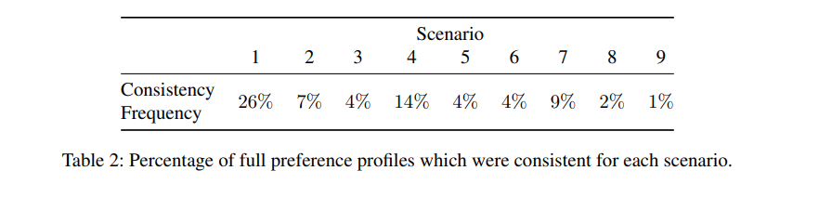
Are people consistent?
In other words, did people agree with any consistent profile (there are four possible options)?
This varied from 1/100 to 1/4 respondents
Generally higher when BMU and Ryan are higher tier
1st, 4th, 7th: Ryan is top-tier -> consistency is higher
BMU and Ryan top tier
BMU and Ryan bottom tier

Slide 24
Survey Limitations
What are some survey limitations (either ones you know where true or suspect are true)?
Respondents were non-experts in faculty hiring
Social desirability: you respond in ways you think would be viewed as favorable, if someone were to see your responses
More noisy
Only 154 “successful” respondents
Priming: randomly assign some participants to believe prioritizing affiliate’s matches would be good
No effect was found – either priming was done poorly or there is simply no effect in this setting

Slide 25
Greedy Stability
Consider a matching M, and say the match of any agent a under M is M(a).
(Alex, UMD) is a greedy blocking pair iff UMD >_{Alex} M(Alex) and there exists some other matching M’ where M’(Alex) = UMD and (M’(UMD), M’(aff(UMD))) >_{UMD} (M(UMD), M(aff(UMD)).
AKA, (Alex, UMD) is a greedy blocking pair exactly when they are not matched and there is another matching that matches them which both prefer
A matching is greedy stable if there are no greedy blocking pairs.

Slide 26
Greedy Stability
MD
Is this a greedy blocking pair?
Capacity 2
MD
MD
Capacity 2
PA
PA
Capacity 2
WV
Matching M

Slide 27
Greedy Stability
If the newly matched pair is happier in M’, then M is unstable
MD
MD
MD
MD
MD
MD
PA
PA
PA
PA
WV
Matching M
WV
Matching M’

Slide 28
Properties of Greedy Stability
Recall: A marketplace is affiliate-agnostic if all university preferences are consistent with their preferences over students.
AKA: Universities care about their own matches first and foremost, and then their students’ matches
Proposition
In an affiliate-agnostic marketplace, the problem reduces to stable marriage.

Slide 29
Properties of Greedy Stability
We no longer assume the marketplace is affiliate-agnostic.
Then, there may be no stable matchings.
WV > PA > MD
MD
(R, WV) > (A, MD) > (T, PA) > (R, PA) > (T, WV)
A
MD
MD > WV > PA
PA
(A, WV) > (T, WV) > (A, MD) > (T, MD) > (R, PA)
R
PA
WV > MD > PA
WV
(A, MD) > (R, MD) > (T, WV) > (R, PA) > (A, PA)
T
WV

Slide 30
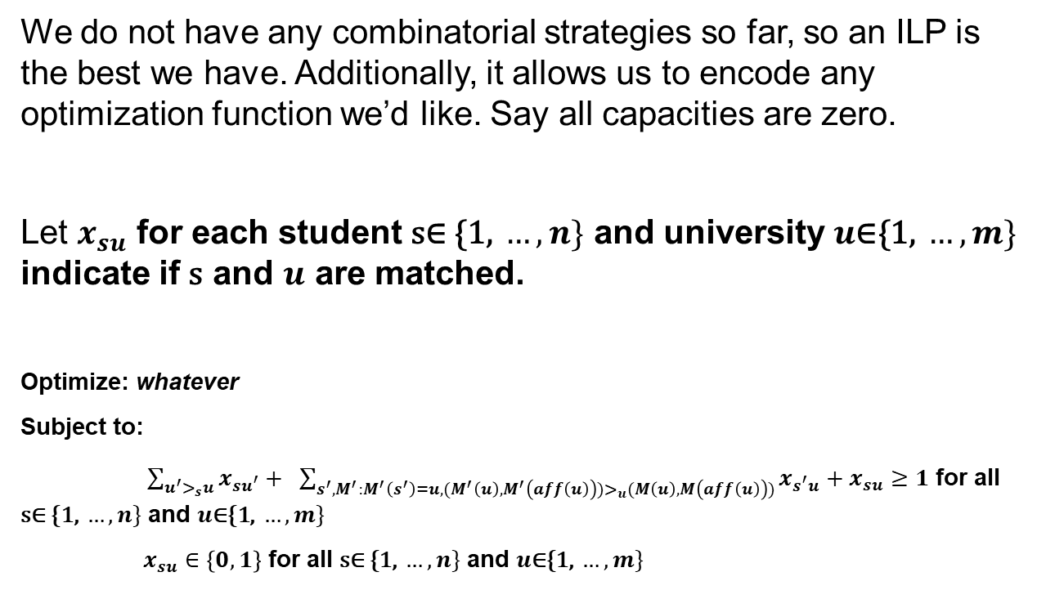
Int. Linear Program for Greedy Stability
We do not have any combinatorial strategies so far, so an ILP is the best we have. Additionally, it allows us to encode any optimization function we’d like. Say all capacities are zero.
Let $x_{su}$ for each student $\text{s}\text{∈} \text{\{1, }…, n\}$ and university $u\text{∈\{1, }…, m\}$ indicate if $\text{s}$ and $u$ are matched.
Optimize: whatever
Subject to:
$\sum_{u^{′}>_{s}u}{x_{su^{′}}}+ \sum_{s^{′},M^{′}:M^{′}\left(s^{′}\right)=u, (M^{′}\left(u\right),M^{′}\left(aff\left(u\right)\right))>_{u}(M\left(u\right),M\left(aff\left(u\right)\right))}{x_{s^{′}u}}+x_{su}≥1$ for all $\text{s}\text{∈} \text{\{1, }…, n\}$ and $u\text{∈\{1, }…, m\}$
$x_{su}∈\left\{0,1\right\}$ for all $\text{s}\text{∈} \text{\{1, }…, n\}$ and $u\text{∈\{1, }…, m\}$
This looks gross! But if you ignore this part it looks the same as our stable marriage ILP

Slide 31
Designing Affiliate Matching Mechanisms
Does an affiliate matching mechanism reify notions of prestige in a way that produces harm?
If you go to a prestigious school, you likely access to better resources that give you a better outcome.
How do current affiliate marketplaces operate?
Can this model be used in some way? Is preference elicitation reasonable? Can we make it strategy-proof?
How much do employers care about their affiliates? How much should they care?
Qualitative results in the survey yielded many different philosophies.
What is the right definition of stability?
Greedy stability is not the only notion of stability. Is it too weak? To strong? Helpful? Unhelpful?

Slide 32
Extension: Dichotomous preferences
Similar existing marketplaces are simplified: each applicant submits their top 2 preferences, schools do initial acceptances based off of this, then it is decentralized.
Why is this good?
It’s easy for people to submit their top 2
Affiliate matching: should students give entire rankings over schools? Can they? Can schools give entire rankings over tuples?
Simplification: Everyone has a binary approval/disapproval indicator for each university/student

Slide 33
Extension: Dichotomous preferences
UMD’s Preferences:
Approve or disapprove of each student for itself
Approve or disapprove of each university for each affiliate
Value of a match:
Start at 0
Add 1 for every match it receives that it likes
Add λ for every match an affiliate receives that it likes
UMD’s match
A’s match
0
MD
1
A
MD
1
PA
1
R
PA
1
WV
0
T
WV
Value of match: 1+ λ

Slide 34
The Value of Dichotomous Prefs
Preference elicitation – simple, easy to get, will never contradict itself
Problem solvability – there is always a stable solution and it can be found efficiently (even in many-to-many matches)
Problems? – is it over simplified? Is our notion of valuation “right”? Does this really model real world problems
Proposed problems – faculty hiring interviews, playdates!, study abroad, student projects, dog breeding

Slide 35







Here IS A DOGGO

